Slide 1


Social Buzz

Slide 2


Today's agenda
Project Recap
Problem
The Analytics Team
Process
Insights
Summary

Slide 3

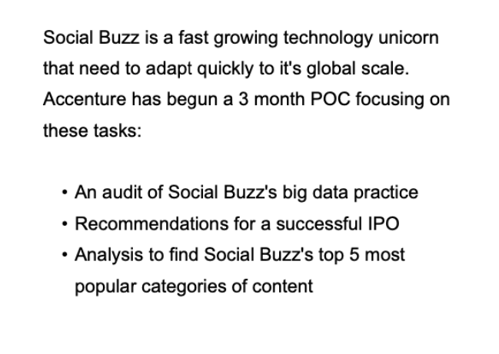
Project Recap

Slide 4

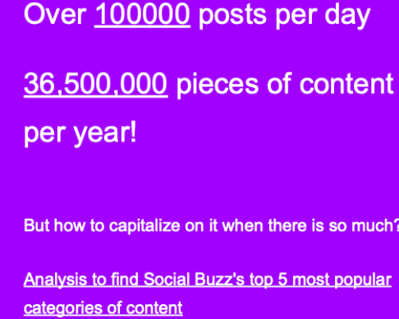
Problem

Slide 5






The Analytics team
Kumud Dhabhai

Slide 6
Process
1
Data Understanding
2
Data Cleaning
3
Data Modelling
4
Data Analysis
5
Uncover Insights
Notes:
d

Slide 7

Insights
16 Unique Categories
Animal Most favorite Category
May with most number of post

Slide 9
Total
Positive
Negative
Neutral

Slide 10

There are a total of 16 distinct content Categories.
Out of which Animal and Science
Categories are the most popular one.
4 type of Content – Photo, Video, Gif and Audio,
Out of which people prefer photo and video.
May month has the highest number of posts.
Summary
Conclusion
Should focus more on the top 5 categories that’s animal, technology,
science, healthy eating and food.
create campaign to specifically target those audiences
Need to maximize in the month of January, may and august as they
number of posts in these month the
highest

Slide 11
Thank you!
ANY QUESTIONS?

